Slide 1
NA Support
Monthly KPI Report
June 2022

Slide 2

Highlights this month
June 2022
Alma Tier 1 Case satisfaction improved by 4%, now above 93% for the month
Alma Tier 2 New analyst started this month
Improved MTTR, now under yearly goal for all case priorities
Primo Support
Cross-training on Alma in preparation for Next Gen Chat
Migrated training to My Learning
Summon Support
Completed two Summon projects
Helped Dev and Cloud with preparation for FTP to MFT migration
Voyager
LC upgrade to 10.3 completed
Rialto, Leganto
Rialto: Interviewing candidates for growth position in EMEA
Leganto: LTI 1.1 deprecated, increase in cases regarding upgrading to LTI 1.3

Slide 3


Open vs closed trends
Illumination
Special notes
KPI automation project began tracking backlog in January 2022

Slide 4
Satisfaction by Month (non-cumulative)
Illumination
Special Notes
Satisfaction data for November starts November 8th, Simple Surveys prior to this date are not included

Slide 5
Chat opened by month
Illumination
Special notes
The Next Gen Chat program will start in July
Rialto chats decreased because of transaction trends

Slide 6
Chat Surveys
Illumination
Special notes

Slide 7
Highlighted Survey Comments – June 2022
Account Number | Survey Comments
01EDMC-SUT | Everyone was great and provided timely assistance.
01UOVSOL | The rep answered my question within the same day and was able to make the changes that we needed.
01UON_K | They made a suggestion for how to address the issue, and then worked back & forth with me to try it out and see how it would work for my situation. In the end, I know what I need to do for this kind of situation.
01TUN | This response was very thorough and worked perfectly.
61UNI-AVON | My request was dealt with extremely quickly and efficiently. Thank you
01SUNY-BUF | I was very pleased and impressed by how quickly the systemic problem was identified and corrected by the Development Team. Support was terrific, too. Thanks!
01ALLIANCE-WU | Great response time and answer.
01UCALG-BOW | I felt the support team went above and beyond to answer my questions.
01UWI | Thank you for quickly addressing this issue.
01WRLC-HOWARD | The solution was offered at once. Very grateful.
01HACC | I liked how the support person followed up to make sure the problem was truly solved.
01GIA | My chat person provided a quick response and helped to make my shelf reporting easier.
01IOWA | My report was responded to quickly and with an acknowledgement of a problem which was escalated and then there was a timely response. All what I'd hope for in response.

Slide 8
Aging Ratio of Cases in the Backlog
Target KPI: 10%
Illumination
Special notes
Aging is defined as ≥ 60 days for High, ≥ 90 days for Other

Slide 9
Mean Time to Resolution This Year
Illumination
Special Notes
Target KPIs for MTTR: High <45 Days, Other <50 Days

Slide 10
Days Since Staff Last Public Comment
Illumination
Special Notes
KPI Goal: ≤ 10% both priorities
Now measuring using the field # Days Since Staff Last Public Comment

Slide 11
Manager Reports

Slide 12
Manager: Callie Alma Tier 1 and Tier 2

Slide 13
Alma Satisfaction (non-cumulative)
Illumination
Special Notes

Slide 14
Alma Cases This Month
Illumination
Special Notes

Slide 15
Alma Aging Cases in Backlog
Illumination
Special Notes

Slide 16
Manager: Jack Discovery Teams (Primo Tier 1, Tier 2 and WFS)

Slide 17
Discovery Satisfaction (non-cumulative)
Illumination
Special Notes
SFX Support at 100% YTD (not shown)

Slide 18
Primo Aging Cases in Backlog
Illumination
Special notes

Slide 19
WFS Aging Cases in Backlog
Illumination
Special notes
WFS team held Aging marathon at end of June to reduce aging backlog

Slide 20
Manager: Linda Voyager, NA Aleph and Projects

Slide 21
Mature Satisfaction Surveys (this month)
Illumination
Special Notes

Slide 22
Mature Products – Open vs. Closed
Illumination
Special notes

Slide 23
Mature Products – Projects This Month
Illumination
Special notes
Projects being staggered due to staffing issue

Slide 24
Mature Products –Projects This Month (Details)
Klient Project: Project Name | Account | Project Products | Project Status | Status
NA220305-01BEREA | Berea College | Voyager Add. License Services | Complete | Completed This Month
NA220298-PIEDM001 | Piedmont Community College |  | Onboarding | Active
NA220281-01BSTNARCH | Boston Architectural College | Voyager Add. License Services | In Progress | Active
NA220280-1LSUS | Louisiana State University Shreveport | 360 Link | Booked | Active
NA220277-01VUNI | Valparaiso University | 360 Link; Summon Discovery Service and Syndetic Solutions for Summon Package | Booked | Active
NA220266-01ATI | Agilent Technologies Inc | 360 Link | Booked | Active
NA220265-1ATI | Agilent Technologies, Inc. | 360 MARC Updates | Booked | Active
NA220261-01ROBTMORR | Robert Morris University | 360 Link; 360 Link; 360 Link; Summon Unified Discovery Service; Summon Unified Discovery Service; Summon Unified Discovery Service | Booked | Active
NA220251-01CIALIB | CIA Library | 360 MARC Updates | Booked | Active
NA220224-1HALCC | Halifax Community College | Summon Unified Discovery Service | In Progress | Active
NA220220-01YALE | Yale University | Voyager | Complete | Completed This Month
NA220197-01NUNI | Niagara University | 360 Link; Summon Unified Discovery Service | Booked | Active
NA220181-1KEU | Kettering University | Summon Unified Discovery Service | Booked | Active
NA220167-01DVU | Delaware Valley University | 360 Link; 360 Link; 360 Link; Summon Unified Discovery Service; Summon Unified Discovery Service; Summon Unified Discovery Service | Booked | Active
NA220113-01MEC | Mercy College |  | Complete | Completed This Month
NA210110-01LOC | Library of Congress | Voyager | In Progress | Active
NA210077-null | South Piedmont Community College | Summon; 360 Link | In Progress | Active
NA210034-01LOC | Library of Congress | Voyager | In Progress | Active
NA210316-01STANFD | Stanford University | SFX | In Progress | Active

Slide 25
Team Lead: Dominic Rialto and Leganto

Slide 26
Rialto Satisfaction and Aging
Illumination
Special Notes

Slide 27
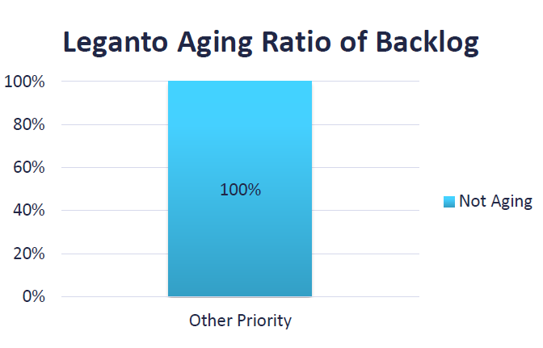
Leganto Satisfaction and Aging
Illumination
Special Notes
Low satisfaction in May was due to only 1 survey being completed (with a score of 2)

